Slide 1

Leveraging GANs, Autoencoders and their Combined Deep Learning Architectures for Anomaly Detection in Multi-Domain Image Data
DEPARTMENT OF COMPUTER SCIENCE AND ENGINEERING
BRAC University | 2025

Slide 2
GROUP MEMBERS
Ashim Chandra Das (20201042)
Anjishnu Banik (20201065)
Noshin Sayara (20201127)
Sazzad Hossain Reaz (20301342)
Supervisor: Dr. Amitabha Chakrabarty

Slide 3


OVERVIEW
INTRODUCTION
MODEL ARCHITECTURES
PROBLEM STATEMENT
METHODOLOGY
RESEARCH OBJECTIVE
MODEL EVALUATION
LITERATURE REVIEW
RESULT ANALYSIS
RESEARCH GAPS
CONCLUSION
DATASET DESCRIPTION

Slide 4
INTRODUCTION
What is Anomaly Detection?
An anomaly is something unusual or different from the normal.
In images, it means detecting things that don’t look right — like a brain tumor in a scan or a defect in a product.
Finding anomalies early can save lives (in healthcare) and prevent problems (in industry).

Slide 5
INTRODUCTION
Traditional methods fall short on complex, high-dimensional image data.
GANs produce realistic data via adversarial training.
Combining GANs & AEs leverages strengths of both.
GAN’s realism .
AE’s stable training and latent representation.
VAEs reconstruct data with probabilistic latent spaces.

Slide 6
PROBLEM STATEMENT
Precise anomaly detection is crucial in medical, industrial, and agricultural sectors.
Aim: Develop a hybrid deep learning model using GANs and AEs to:
Improve image reconstruction
Enhance unsupervised anomaly detection and area segmentation.

Slide 7


RESEARCH OBJECTIVE
1. Investigate GAN architectures and loss functions for high-precision image reconstruction.
2. Enhance GANs with autoencoders for improved accuracy.
3. Analyze AE variants: Convolutional VAE, Beta-VAE, CVAE, etc.
4. Visualize and interpret learned representations for outlier detection.
5. Evaluate performance on diverse datasets (Medical, Industrial, Agricultural).
6. Unsupervised learning on normal data
7. Reconstruction based anomaly detection.
8. attention mechanism for feature focus
9. Multi-model error analysis

Slide 8
LITERATURE REVIEW
GANs:
* Effective for generating high-quality images
* Prone to instability and mode collapse
AEs and VAEs:
* Reliable training, interpretable latent spaces
* Can produce blurrier outputs
Hybrid Models:
* Combine strengths of both
* Improved anomaly detection accuracy

Slide 9
RESEARCH GAPS
Limited labeled abnormal data
Subtle early-stage anomalies
Inconsistent performance across 3D/2D and real-time applications.
Need for robust, domain-independent models with interpretability.

Slide 10
DATASET DESCRIPTION
BRAIN MRI
MVTEC AD
PLANT DISEASE
comprises MRI images of brains and some are normal and others have tumors
Used to evaluate how well the models detect anomalies
consists of pictures of everyday items like bottles, pills, and wires, and some are flawless, so others have defects
Used to evaluate model performance in visual quality control scenarios
consists of pictures of healthy and diseased leaves from various crops
Helps test the model’s ability to generalize anomaly detection to non-medical, real-world data.

Slide 11
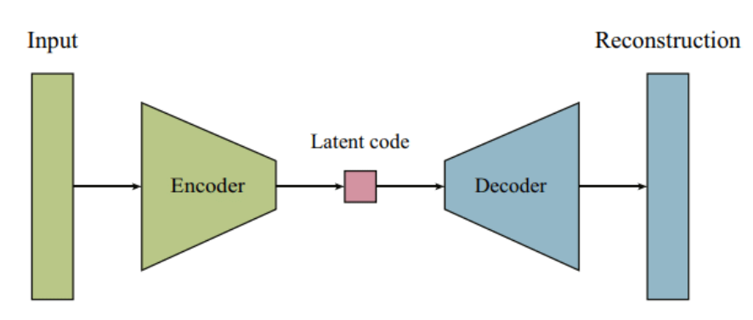
MODEL ARCHITECTURES FOR RECONSTRUCTION-BASED ANOMALY DETECTION
AUTOENCODER-BASED
BASIC STRUCTURE OF AE
MODELS EXPLORED
Fully Connected Autoencoder
Convolutional Autoencoder
Variational Autoencoder
Beta Variational Autoencoder
Conditional Variational Autoencoder
Vector Quantized Variational Autoencoder

Slide 12
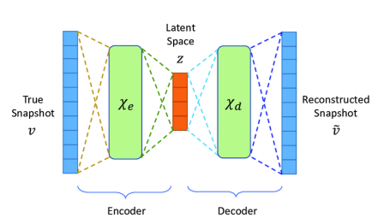
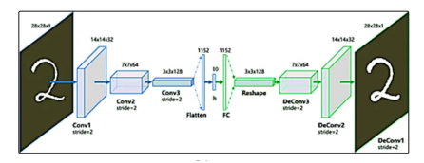
MODEL ARCHITECTURE (CONT.)
FULLY CONNECTED AE
CONVOLUTIONAL AE
Input layer receives flattened input data.
Multiple fully connected layers reduce dimensionality.
compress input into a latent representation.
Dense layers expand latent space back to original dimensions. Output layer reconstructs input.
Stacked convolution + pooling layers to extract features and reduce size.
Final output is flattened and passed to a dense layer.
Compressed 3D tensor representation
Upsampling + convolution layers to reconstruct the original image

Slide 13
MODEL ARCHITECTURE (CONT.)
VAE
BETA VAE
Encoder:
Instead of just compressing the input, it learns two things: the mean (μ) and standard deviation (σ) of a distribution.
Latent Space:
From this distribution, we sample a point (z) using a simple trick: z = μ + σ × ε (where ε is random noise). This helps the model stay smooth and learn more general features.
Decoder:
Takes the sampled z and tries to reconstruct the original input.
regular VAE, but with a stronger push for disentanglement in the latent space
The key change: adds a β (beta) term to
control the weight of KL divergence
Reason of adjusting Beta:
By adjusting β, we guide the model to
not just memorize the input but to
truly understand the key factors behind it

Slide 14
MODEL ARCHITECTURE (CONT.)
CVAE
VQ-VAE
Takes both the input data and a label (condition) as input.
Learns the mean (μ) and standard deviation (σ) of the latent distribution based on that condition.
learns discrete and interpretable latent spaces through vector quantization process
allows models to learn categorical (symbol-like) latent variables, rather than continuous ones.

Slide 15
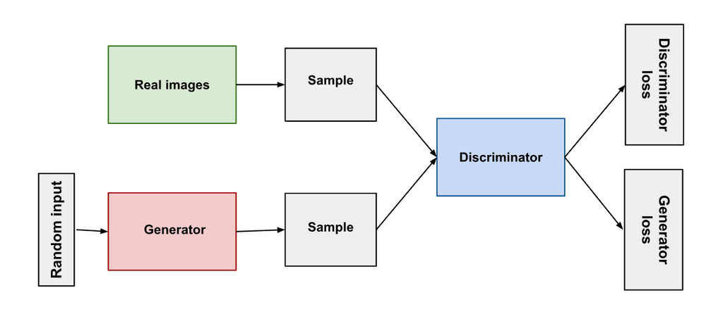
GAN-BASED MODEL
ANOGAN
Generator:
Learns to generate images from random noise (z) that resemble normal data.
Discriminator (D):
Trained to tell apart real (normal) and
fake (generated) images.
detects anomalies through searching
the Latent space

Slide 16
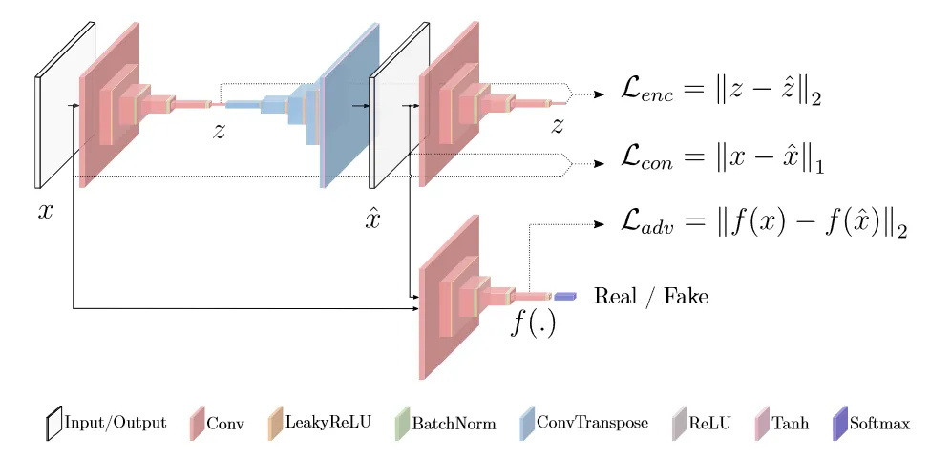
GANomaly
Encoder (E): Maps input image x to latent space z
Decoder (G): Reconstructs image G(z) from latent space z
Second Encoder (E′): Maps reconstructed image G(z) to latent z′

Slide 17
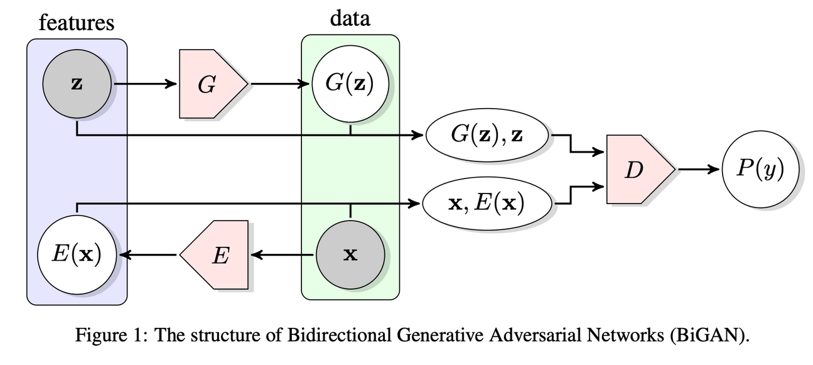
Bi-GAN
Generator (G): Generates data from noise.
Encoder (E): Maps real data to latent space.
Discriminator (D): Distinguishes between:
(x, E(x)) – real data & encoded latent
(G(z), z) – fake data & input latent

Slide 18
Methodology
1. Data Preparation
Collect labeled image data (Yes = Diseased, No = Healthy) from Kaggle
Relabel and organize data into two classes: Healthy and Diseased
Apply data augmentation to balance the dataset
Resize to 128x128
Normalize pixel values
Split healthy data 80% for training and 20% testing
2. Training Phase
Use only Healthy/Good data for training

Slide 19
Methodology(Continued)
3. Testing Phase
Merge Healthy/Good test samples with Diseased/Defected samples.
Pass all test images through the trained model.
Calculate anomaly scores based on reconstruction or latent distance.
4. Decision & Evaluation
Apply a predefined threshold on anomaly scores.
Score < Threshold ⇒ Healthy/Good.
Score ≥ Threshold ⇒ Diseased/Defected.

Slide 20
Model Evaluation Metrics
1. Accuracy
Overall correctness of the model
Accuracu = (TP+TN)/(TP+TN+FP+FN)
2. Precision
How many predicted Diseased/Defected are truly Diseased/Defected.
Precision = TP/(TP+FP).
3. Recall (Sensitivity)
How many actual Diseased/Defected are correctly predicted.
Recall = TP/(TP+FN).
4. F1 Score
Harmonic mean of Precision and Recall
F1 Score = 2×(Precision×Recall)/(Precision+Recall)

Slide 21
Model Evaluation Metrics(Continued)
5. Specificity
How many actual Healthy/Good are correctly predicted
Specificity=TN/(TN+FP)
6. AUC-ROC
Measures model’s ability to distinguish between classes
AUC near 1.0 → Excellent separation
7. Confusion Matrix
Displays TP, TN, FP, FN
Provides a complete picture of prediction performance

Slide 22
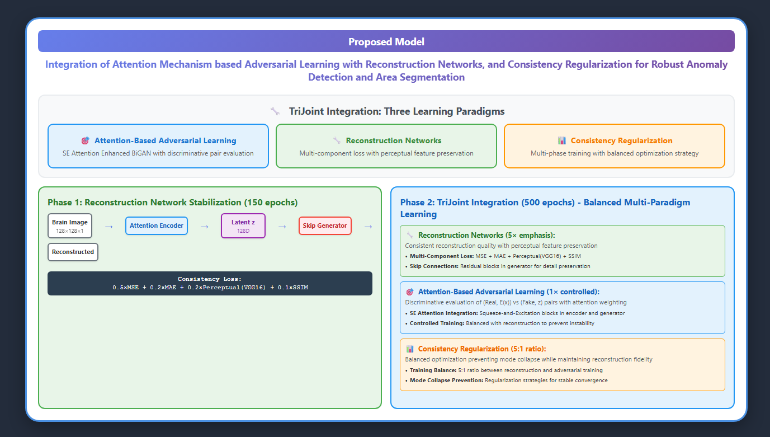

Slide 23
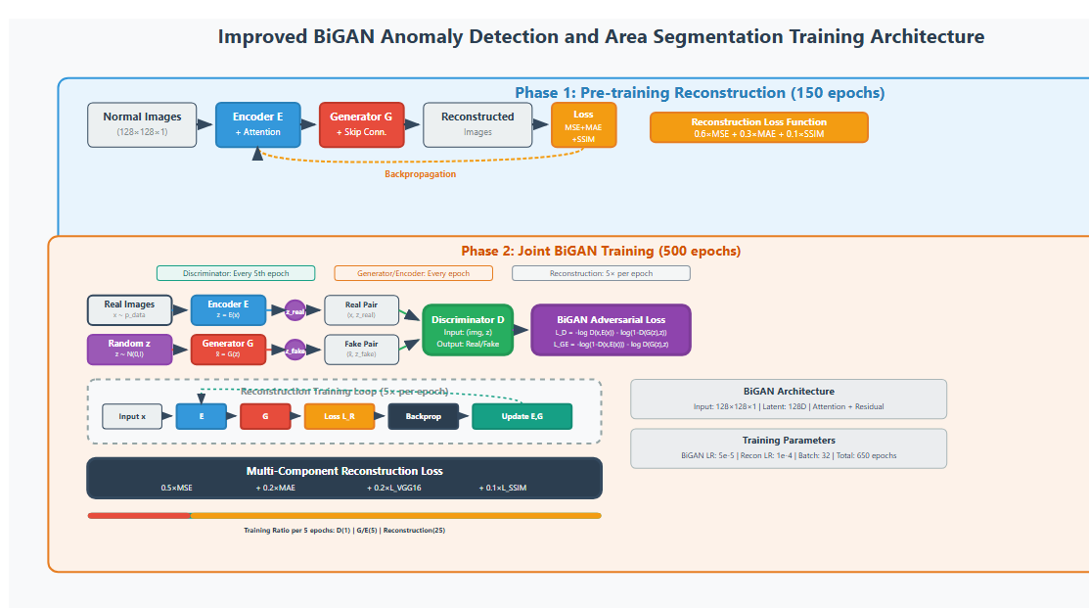

Slide 24
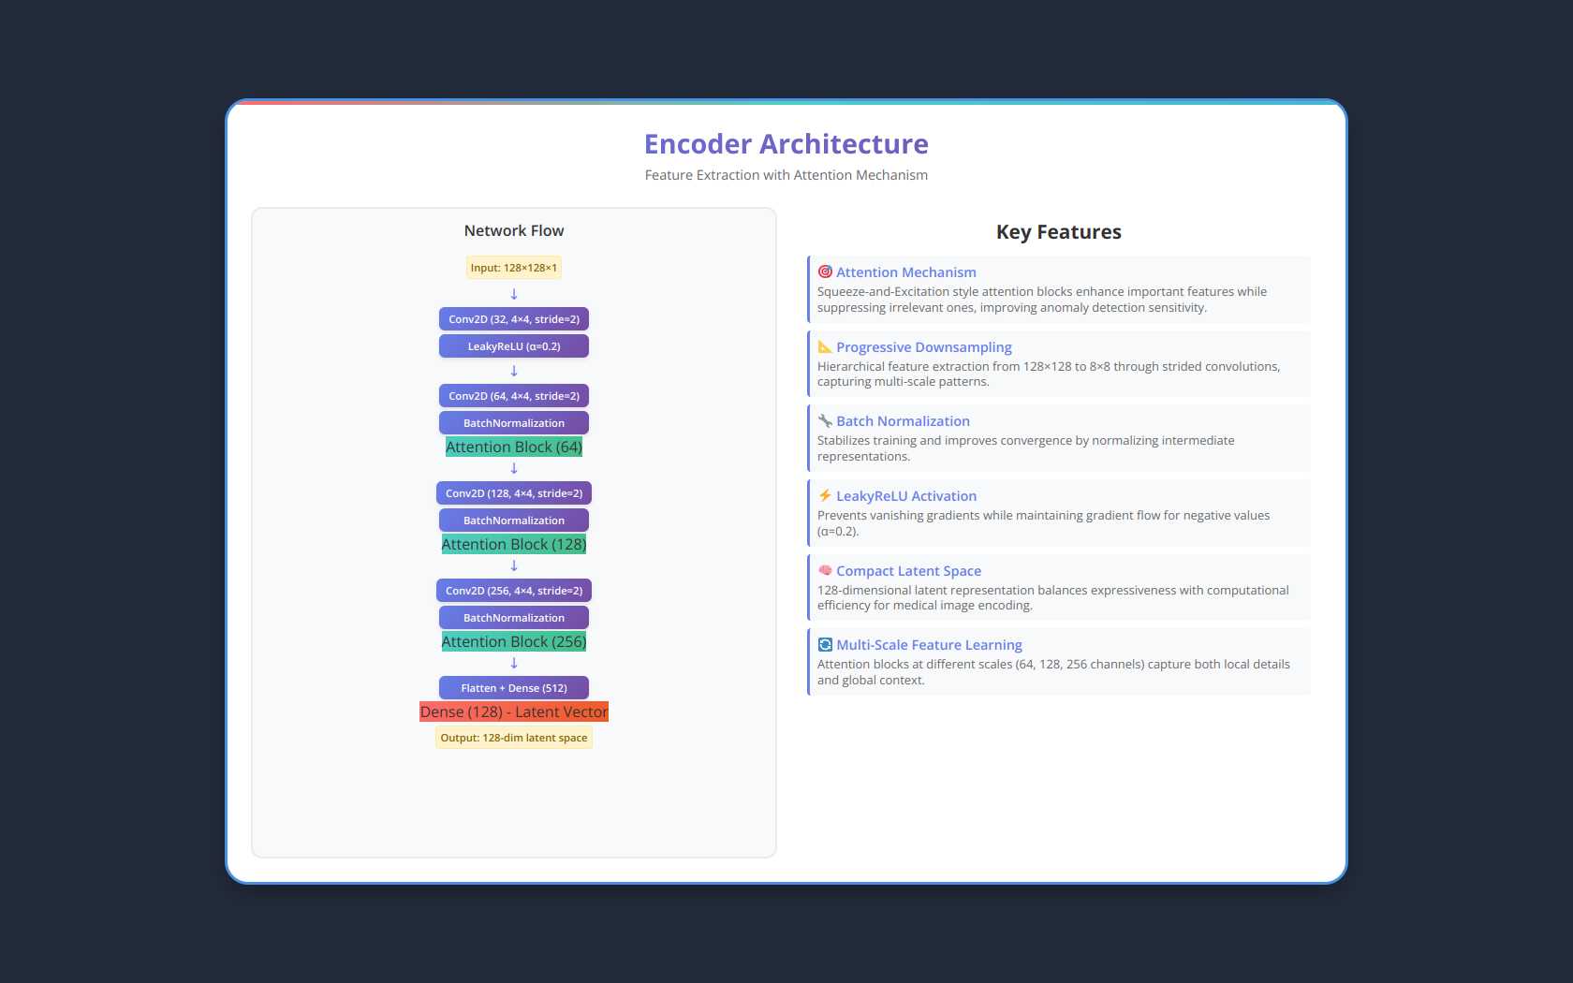

Slide 25
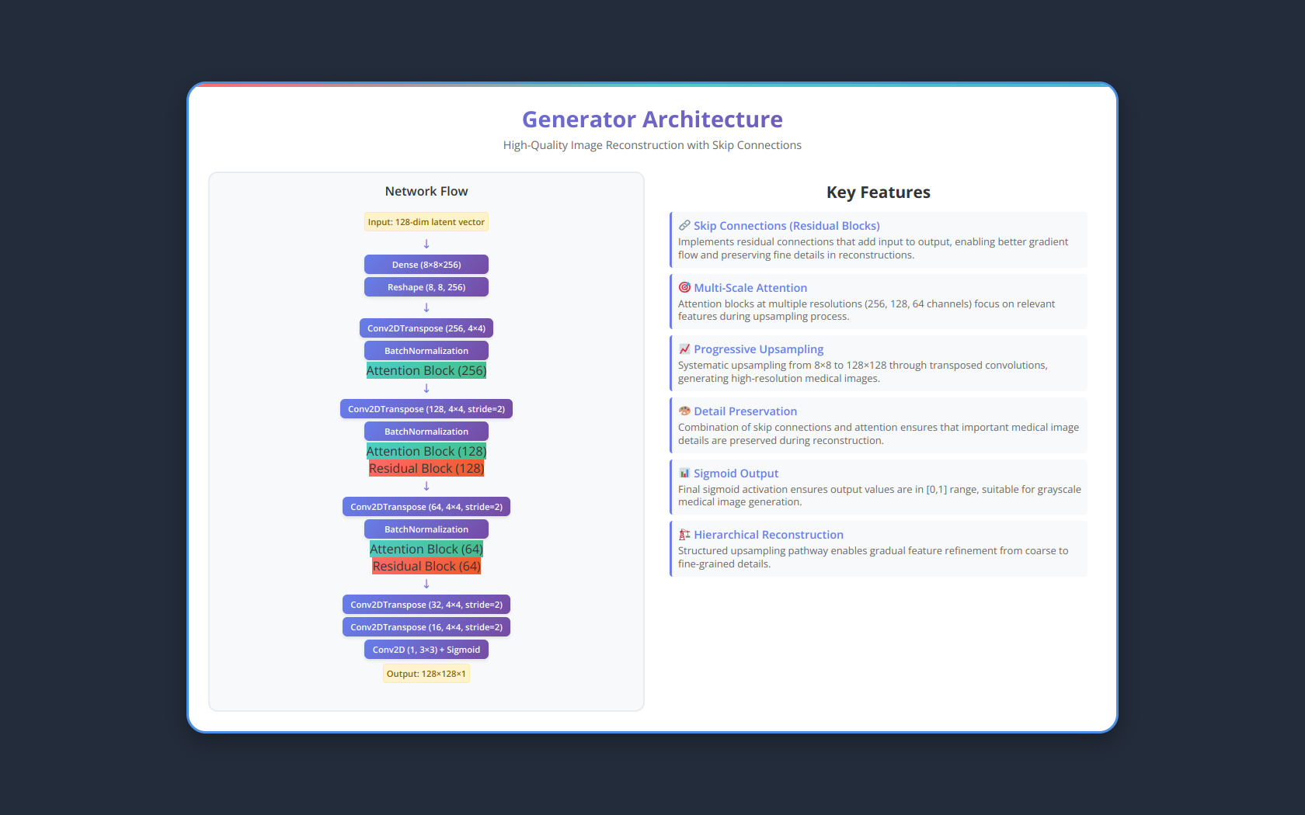

Slide 26


Slide 27
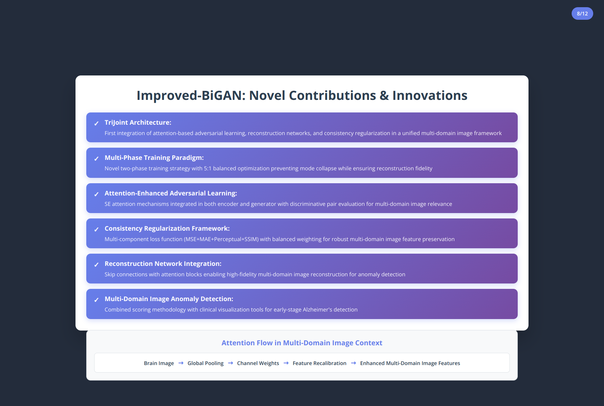

Slide 28
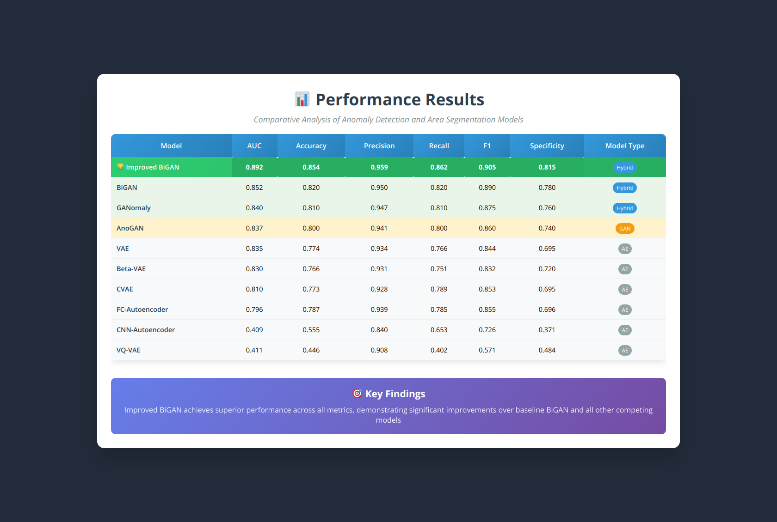

Slide 29
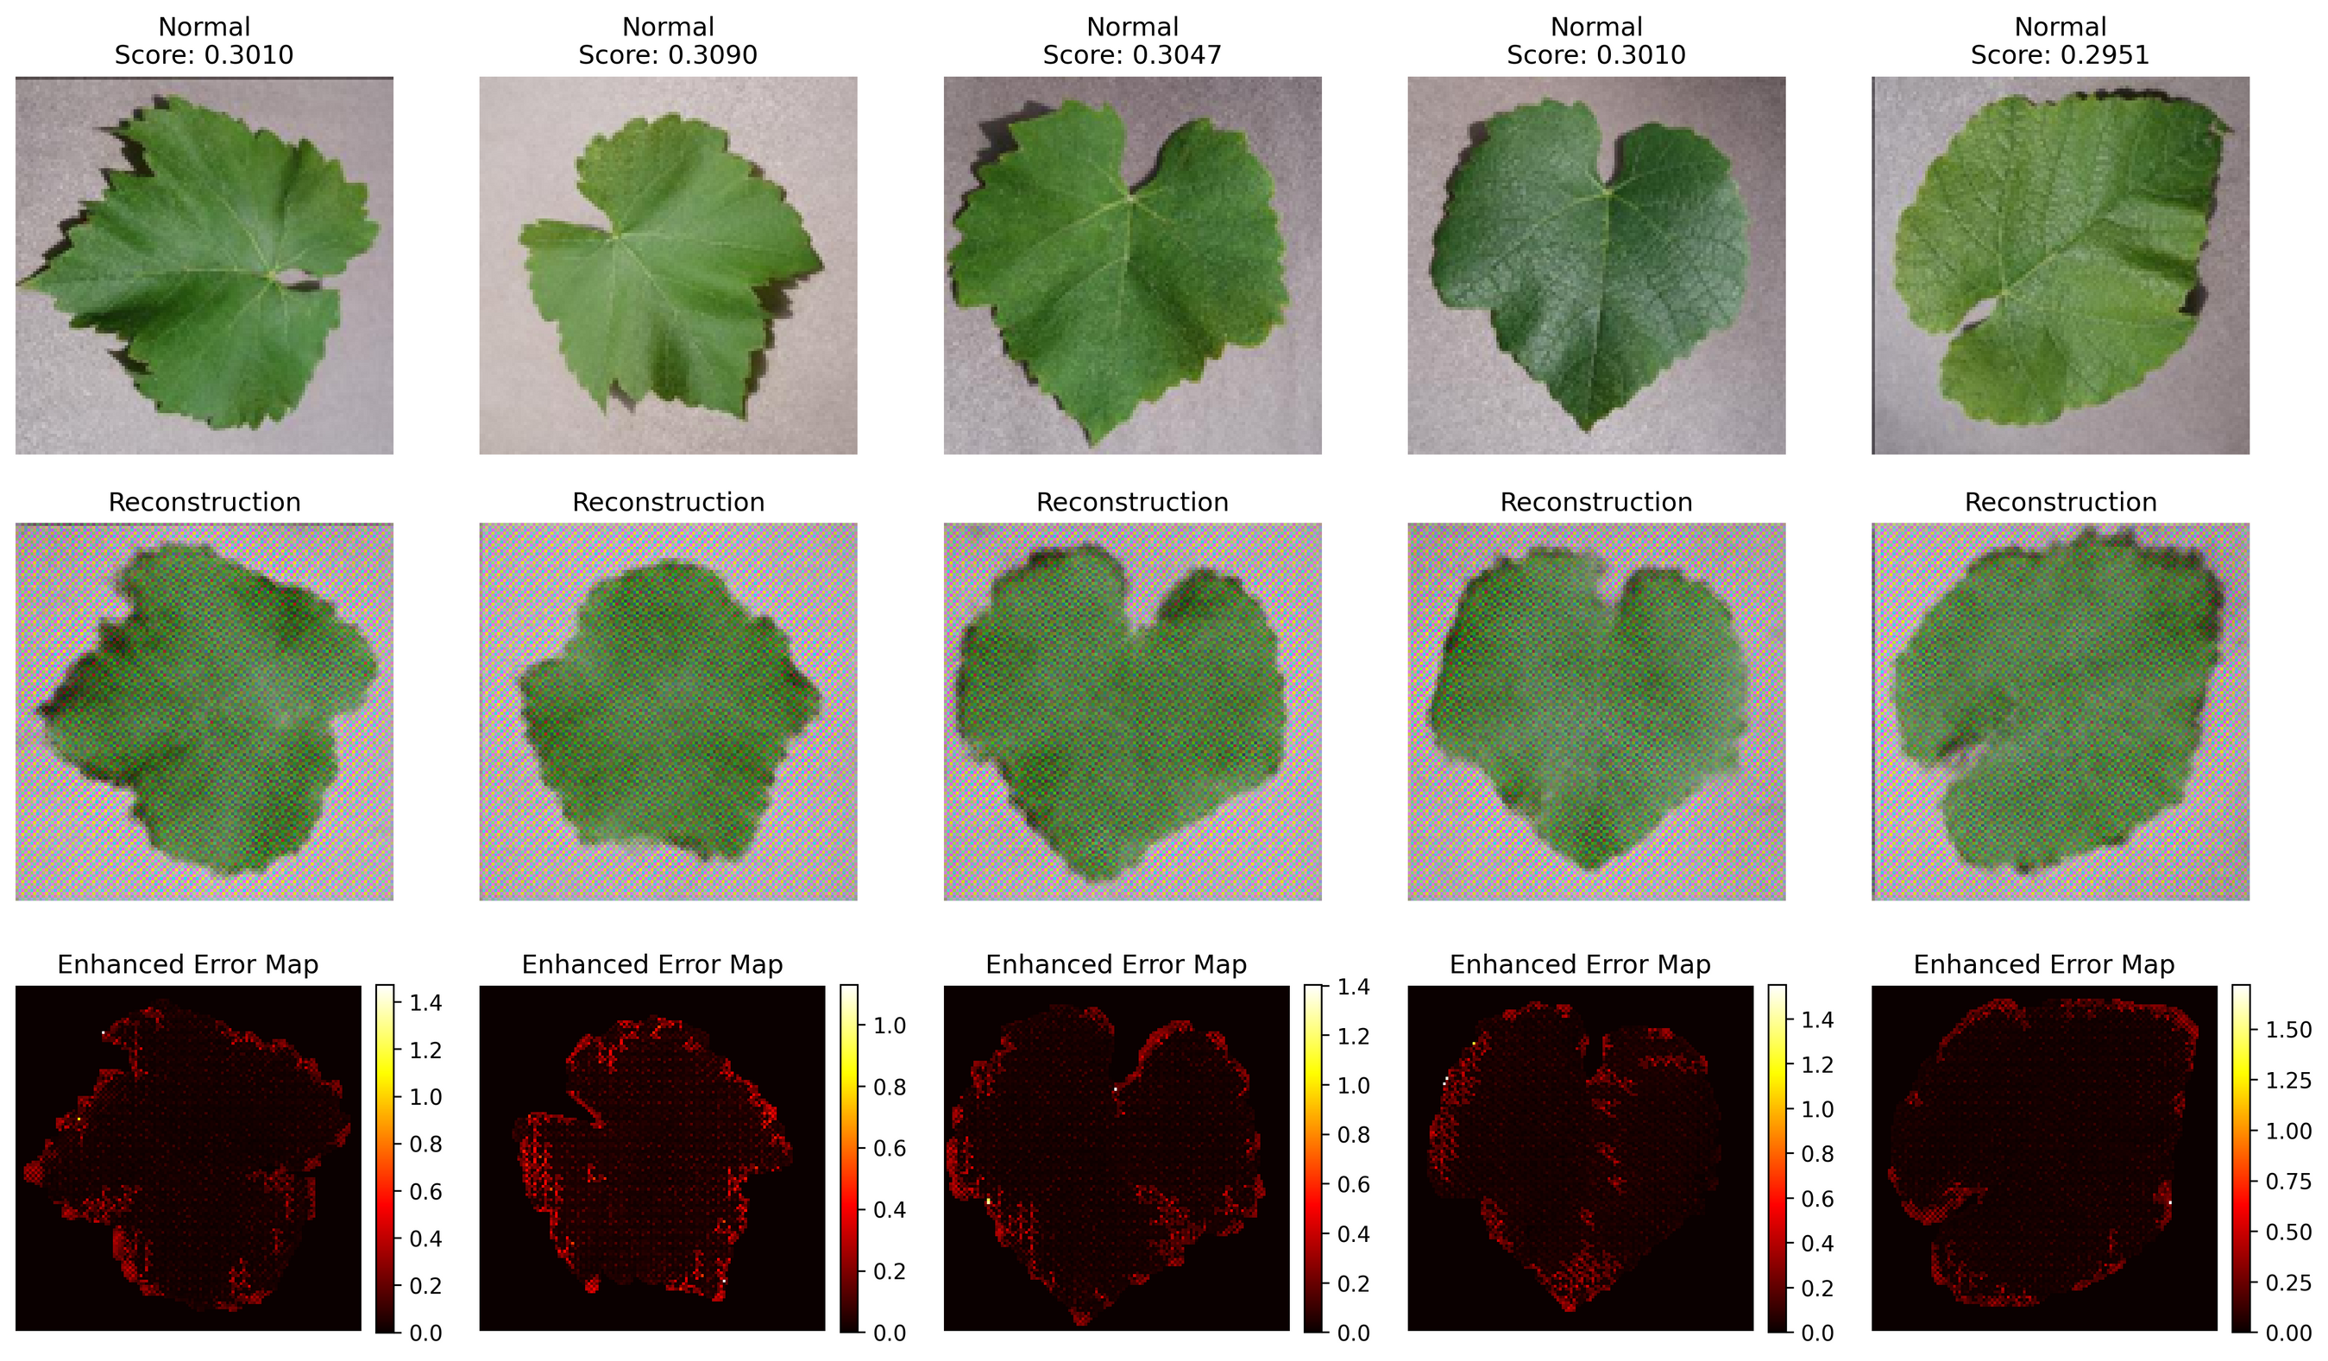
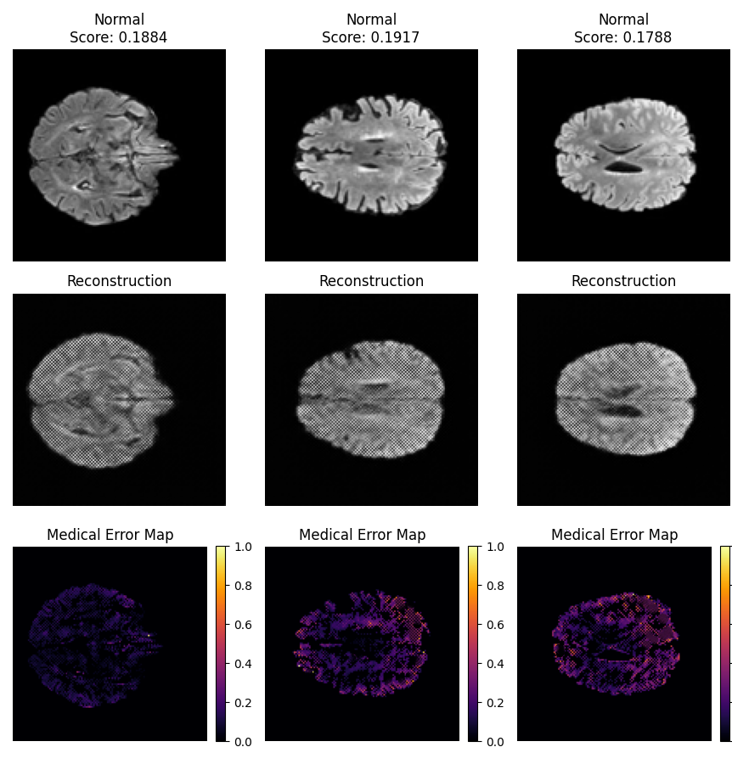

Slide 30
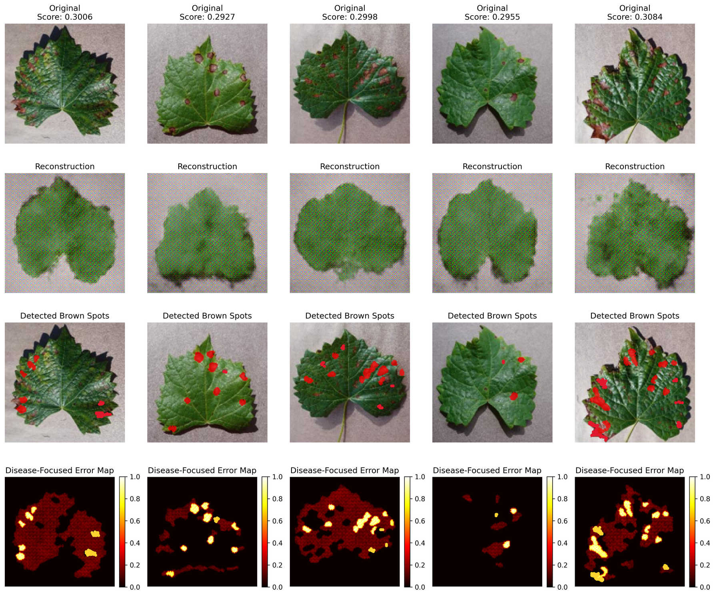
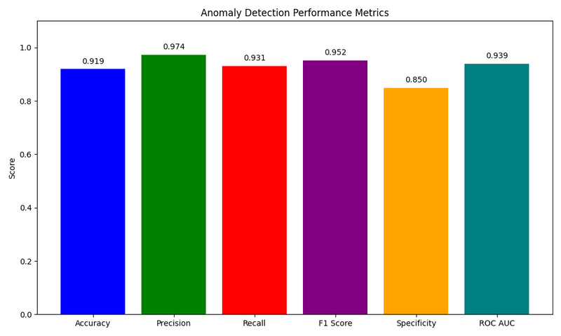
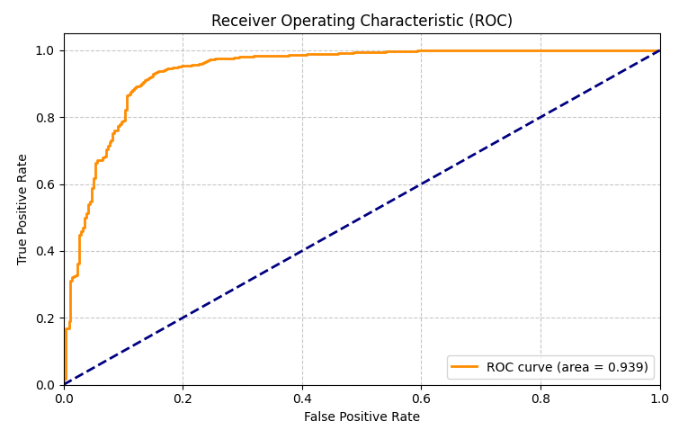
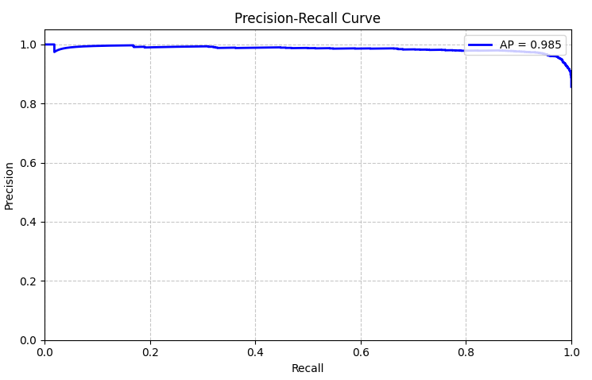

Slide 31
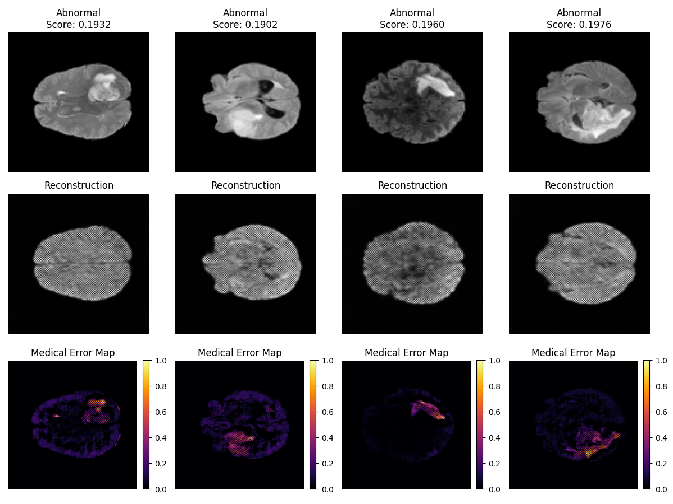
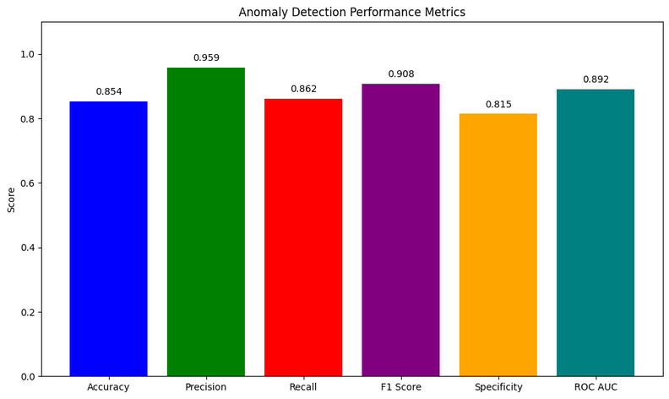
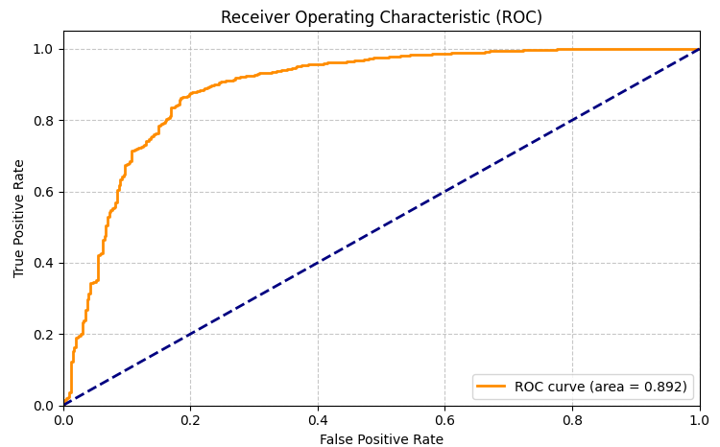
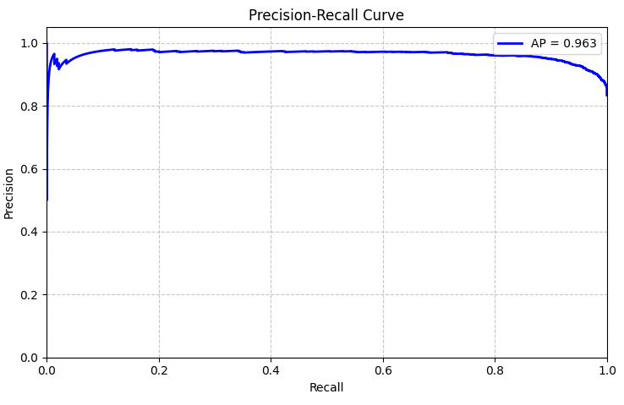

Slide 32
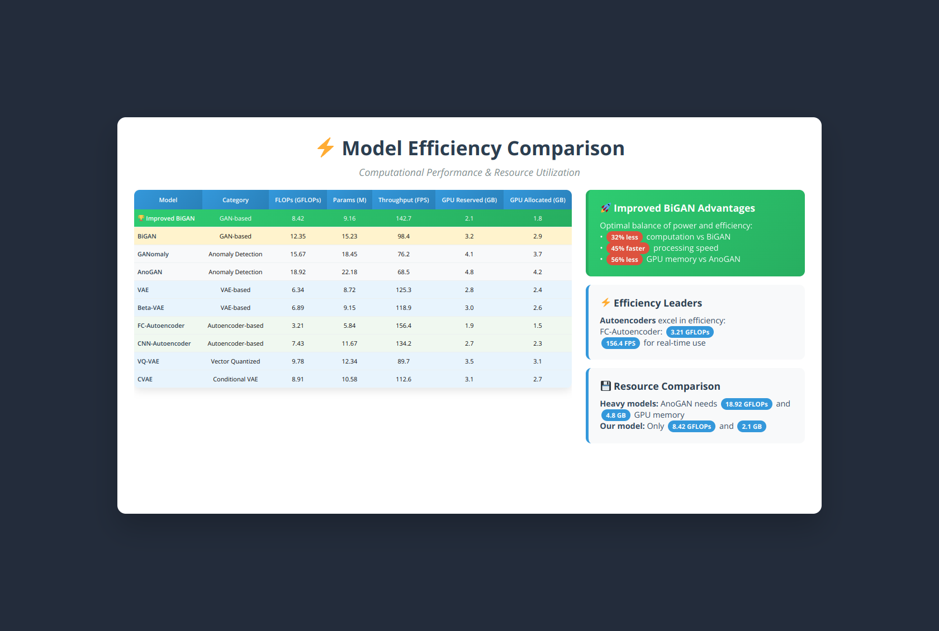

Slide 33


Slide 34


Slide 35
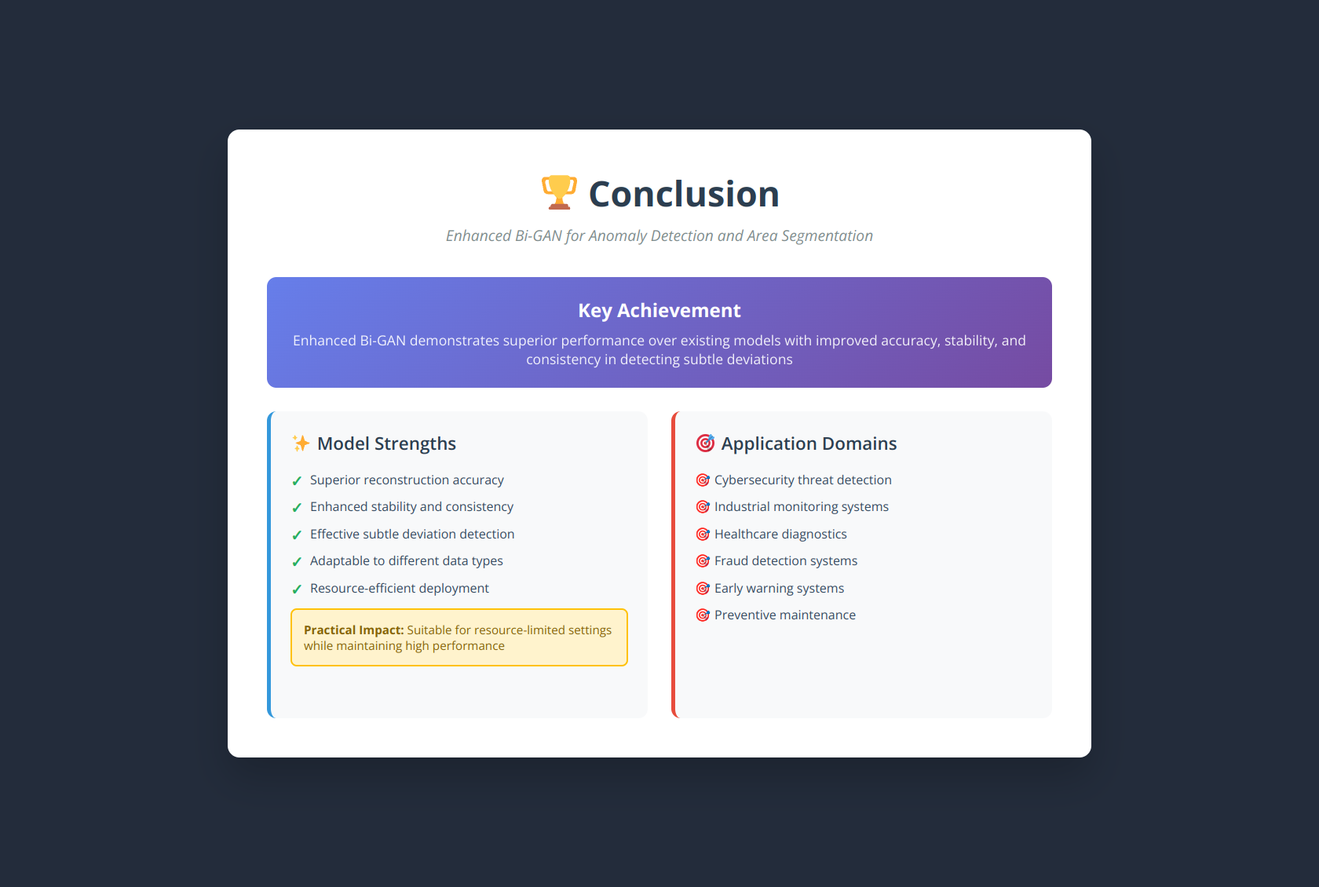

Slide 36
THANK
YOU

